Slide 1
The U.S. Midterm Elections Approach:
The American public’s views in 2018
Jocelyn Kiley
Associate Director of Research

Slide 2


What is Pew Research Center?
Pew Research Center is a nonpartisan fact tank that informs the public about the
issues, attitudes and trends shaping America and the world. It does not take policy
positions. The Center conducts public opinion polling, demographic research, content
analysis and other data-driven social science research. It studies U.S. politics and policy;
journalism and media; internet, science and technology; religion and public life; Hispanic
trends; global attitudes and trends; and U.S. social and demographic trends. All of the
Center’s reports are available at www.pewresearch.org. Pew Research Center is a
subsidiary of The Pew Charitable Trusts, its primary funder.
Follow us on Twitter at:
@pewresearch
@facttank

Slide 3
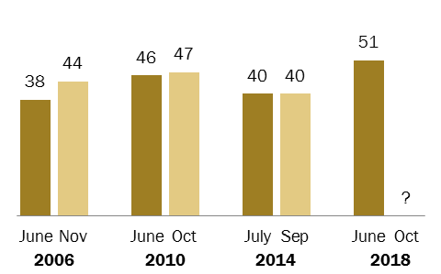
Voters express higher levels of enthusiasm than in prior midterms
% of registered voters who say they are more enthusiastic than usual about voting
Source: Survey of U.S. adults conducted June 5-12, 2018.

Slide 4
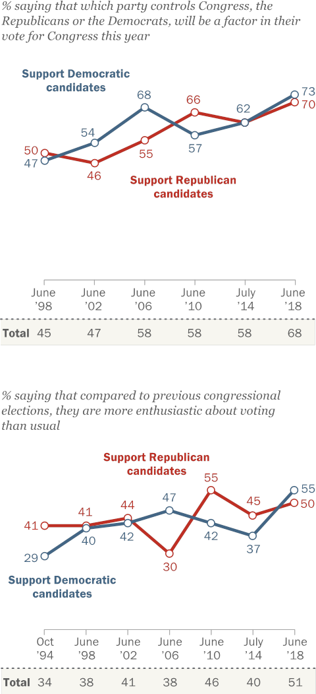
Voter engagement is high among members of both parties
% saying that compared to previous Congressional elections, they are
more enthusiastic about voting than usual
Source: Survey of U.S. adults conducted June 5-12, 2018.

Slide 5
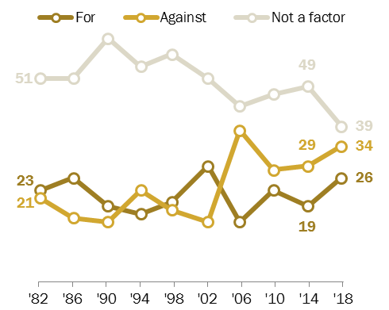
Most say Trump a factor in 2018 vote
% of registered voters who they think of their vote as ___ the president
Source: Survey of U.S. adults conducted June 5-12, 2018.

Slide 6

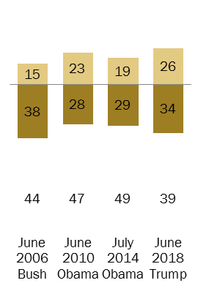
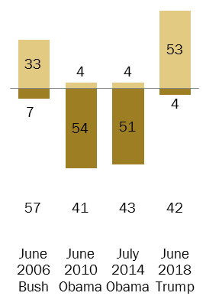
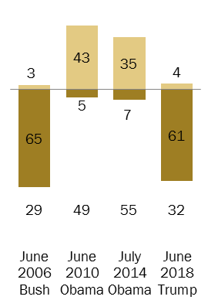
Majority of Democrats say they consider their midterm vote as a vote against Trump
Do you think of your vote for Congress as a vote FOR the president, AGAINST the president or isn’t the president much of a factor in your vote? (%)
Among all
registered voters
Among Rep/Lean Rep registered voters
Among Dem/Lean Dem registered voters
Source: Survey of U.S. adults conducted June 5-12, 2018.

Slide 7
Control of Congress matters more for both parties’ voters than in 2014
% saying that which party controls Congress, the Republicans or the Democrats, will be a factor in their vote for Congress this year, among those who…
Source: Survey of U.S. adults conducted June 5-12, 2018.

Slide 8
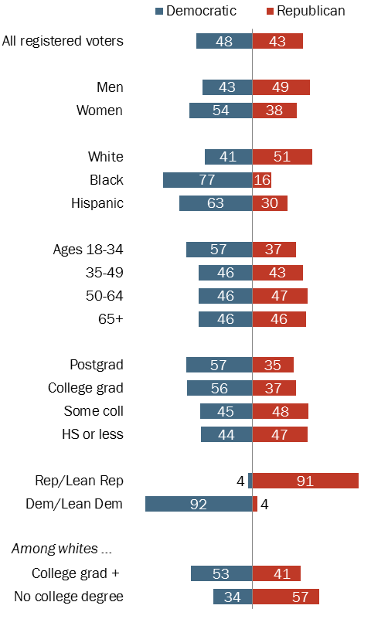
Current congressional vote preferences
% of registered voters who say they support or lean toward the ___
candidate for Congress in their district
Source: Survey of U.S. adults conducted June 5-12, 2018.

Slide 9
Key issues in the election

Slide 10
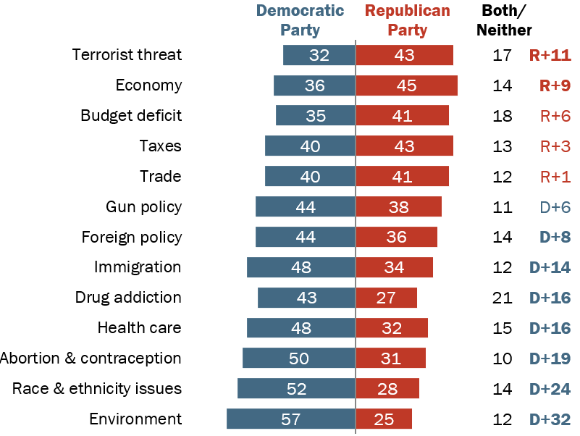
Democrats hold large advantage over GOP on several issues; Republican Party leads on the economy
% who say each party could do a better job dealing with …
Source: Survey conducted June 5-12, 2018.

Slide 11
Voters in both parties cite immigration as an issue they want discussed
What one issue would you most like to hear the candidates in your state or district talk about this fall? [OPEN END]
Source: Survey of U.S. adults conducted June 5-12, 2018.

Slide 12
Most Americans favor granting legal status to immigrants who came to the U.S. illegally as children, oppose wall expansion
% who ___ granting permanent legal status to immigrants who came to the U.S. illegally when they were children
% who ___ substantially expanding the wall along the U.S. border with Mexico
Oppose Favor
Source: Survey of U.S. adults conducted June 5-12, 2018.

Slide 13
Views of trump

Slide 14
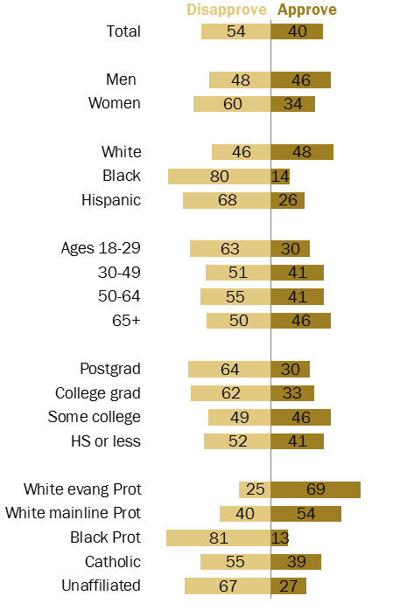
Race, gender, age and education differences in Trump job approval
% who ___ of the way Trump is handling his job as president
Source: Survey of U.S. adults conducted
June 5-12, 2018.

Slide 15
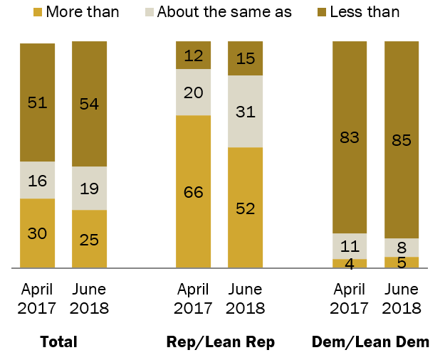
Most trust what Trump says less than previous presidents
% who say they trust what Trump says ___ what prior presidents said in office
Source: Survey of U.S. adults conducted June 5-12, 2018.

Slide 16
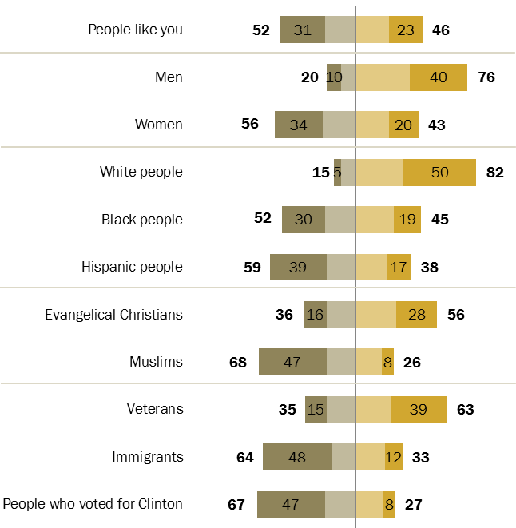
Trump seen by most as respecting white people and men; far fewer say he respects women and minorities
% who say Trump has ____ of respect for each
Source: Survey of U.S. adults conducted
June 5-12, 2018.

Slide 17

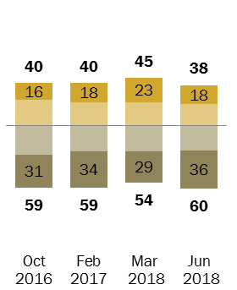
Majority of Americans say Trump has ‘not too much’ or no respect at all for the nation’s democratic institutions and traditions
% who say Trump has ___ of respect for this country’s
democratic institutions and traditions
Total
Source: Survey of U.S. adults conducted June 5-12, 2018.

Slide 18
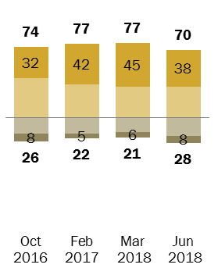
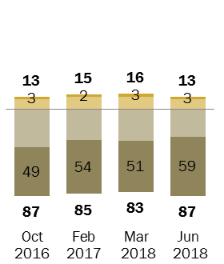
Views of Trump’s respect for the nation’s democratic institutions and traditions largely split along party lines
% who say Trump has ___ of respect for this country’s
democratic institutions and traditions
Total
Rep/Lean Rep
Dem/Lean Dem
Source: Survey of U.S. adults conducted June 5-12, 2018.

Slide 19
democratic values

Slide 20
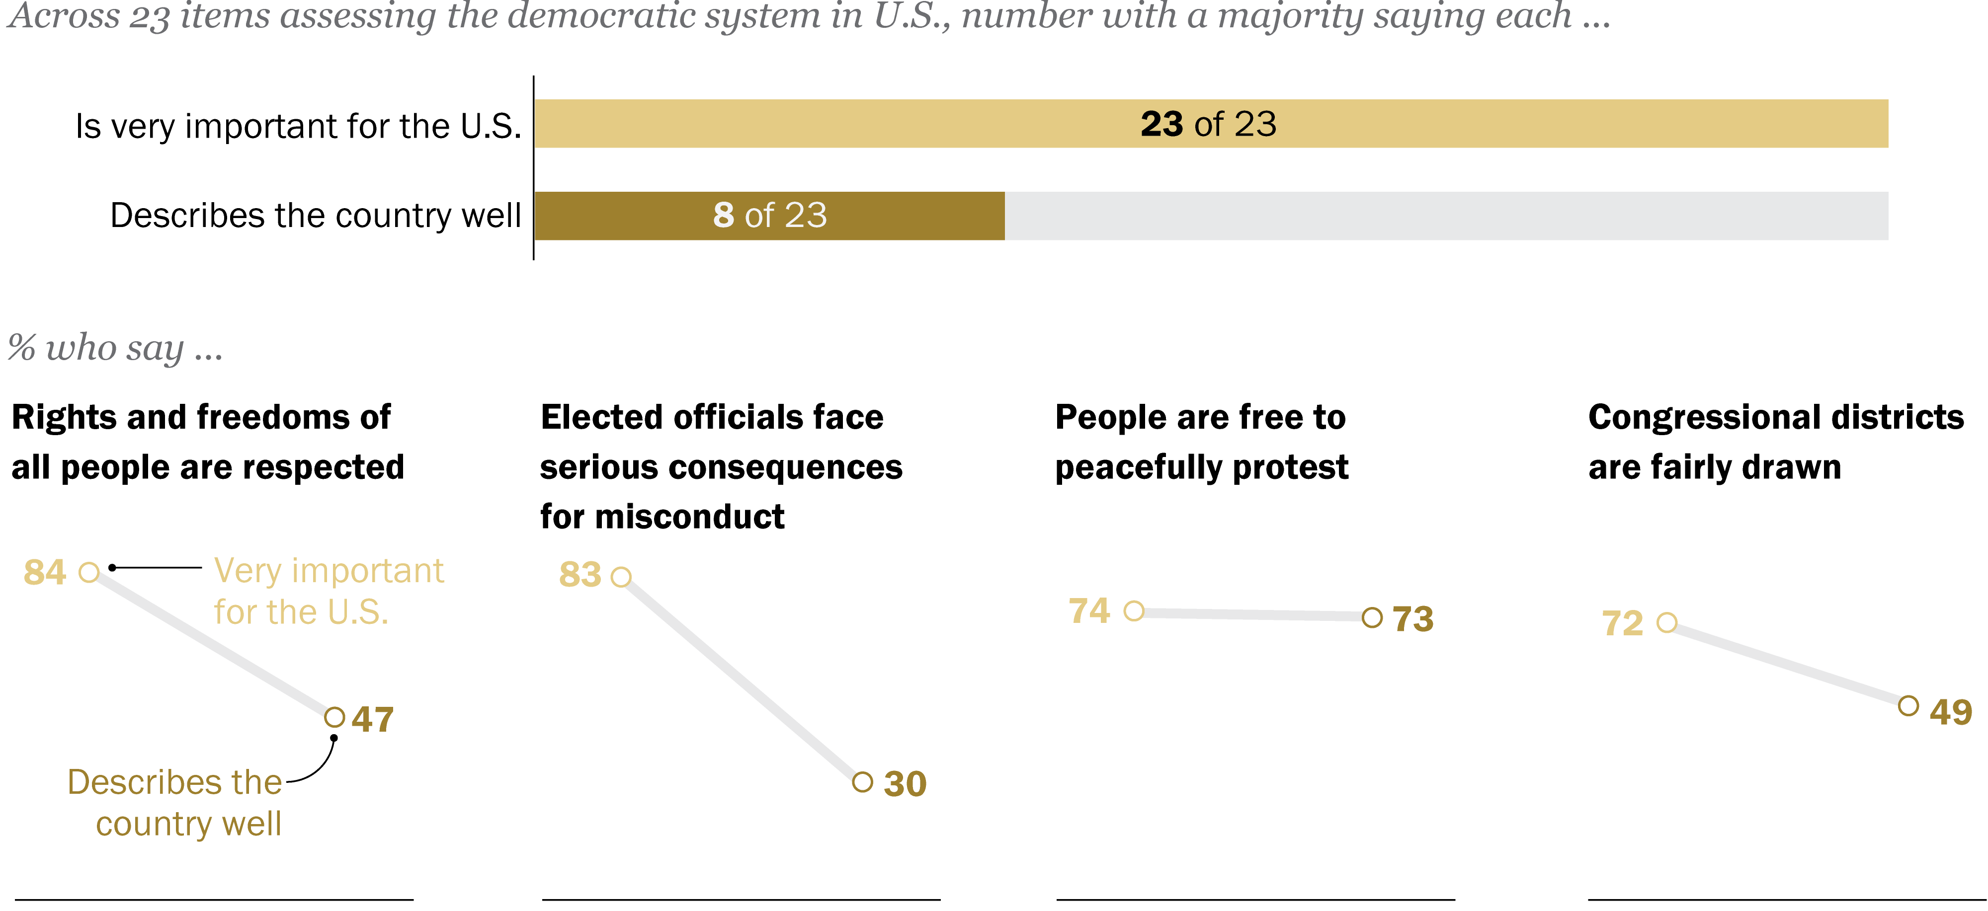
Democracy in America: Ideals vs. reality
Source: Survey of U.S. adults conducted Jan. 29-Feb. 13, 2018.

Slide 21
Wide partisan gaps in views of some aspects of political system, criticism from both parties on others
% of ___ who say each describes the country very/somewhat well …
Source: Survey of U.S. adults conducted Jan. 29- Feb.13, 2018.

Slide 22
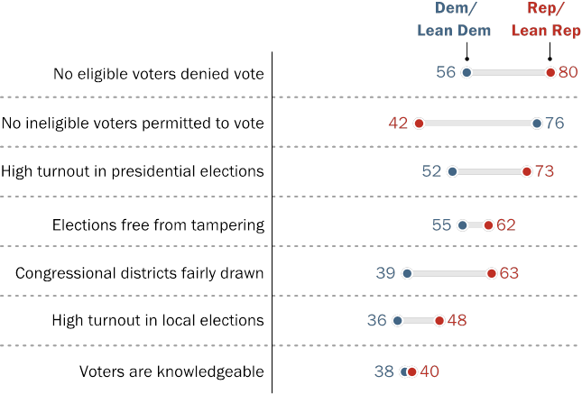
Republicans, Democrats have starkly different perceptions of voting by eligible and ineligible voters
% who say each describes U.S. elections very/somewhat well …
Source: Survey of U.S. adults conducted Jan. 29-Feb. 13, 2018.

Slide 23
foreign policy

Slide 24
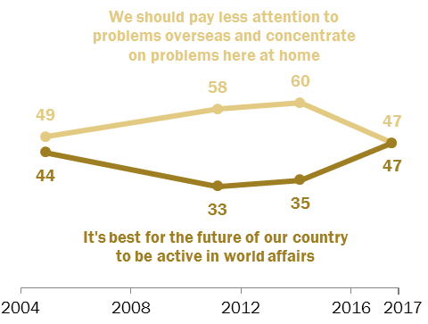
Increase in the share of Americans who say the U.S. should take an active role in world affairs
% who say…
Source: Survey of U.S. adults conducted June 8-July 9, 2017.

Slide 25
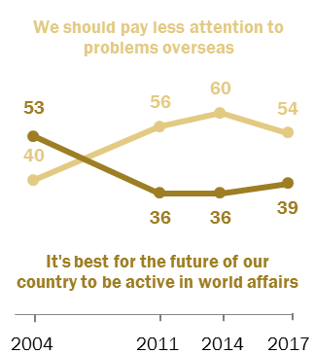
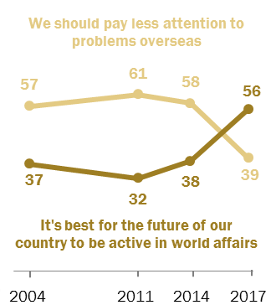
Democrats drive the shift in views about U.S. involvement in international affairs
% who say …
Among Republicans and
Republican leaners
Among Democrats and
Democratic leaners
Source: Survey of U.S. adults conducted June 8-July 9, 2017.

Slide 26
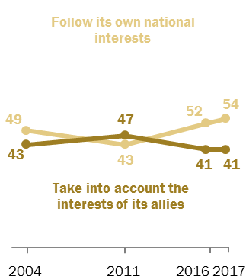
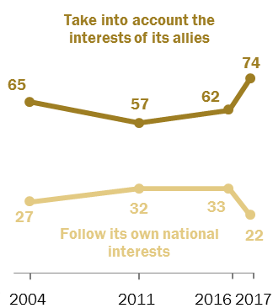
Democrats increasingly say U.S. should take into account interests of its allies in foreign policy
% who say the U.S. should …
Among Republicans and
Republican leaners
Among Democrats and
Democratic leaners
Source: Survey of U.S. adults conducted June 8-18 and June 27-July 9, 2017.

Slide 27
Americans want greater cooperation with most world powers
In the future, our country should cooperate ___ with …
Source: Survey of U.S. adults conducted Oct. 6-10, 2017.

Slide 28
Democrats more likely than Republicans to want greater cooperation with Europe, China
In the future, our country should cooperate more with …
Source: Survey of U.S. adults conducted Oct. 6-10, 2017.

Slide 29
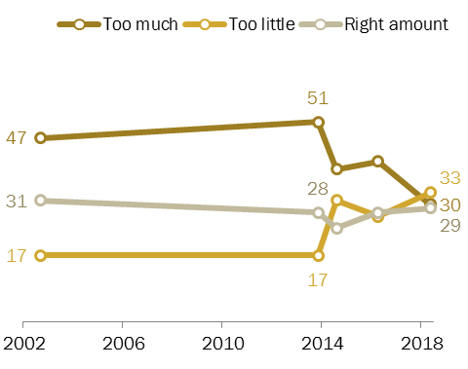
Fewer Americans say U.S. does
‘too much’ in solving world problems
In terms of solving world problems, U.S. does … (%)
Source: Survey of U.S. adults conducted April 25-May 1, 2018.

Slide 30
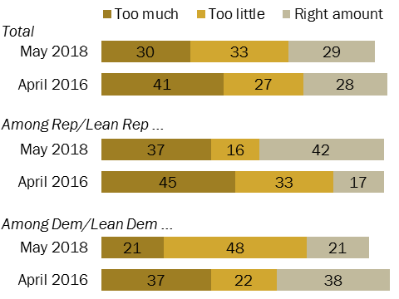
Nearly half of Democrats now say U.S. does ‘too little’ to solve world problems
In terms of solving world problems, U.S. does … (%)
Source: Survey of U.S. adults conducted April 25-May 1, 2018.

Slide 31
Americans say other powers are doing too little to help solve global problems
Do you think __ does too much, too little or the right amount
to help solve global problems?
Source: Survey of U.S. adults conducted Oct. 6-10, 2017.

Slide 32
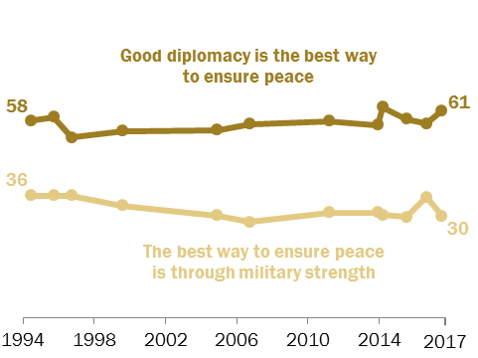
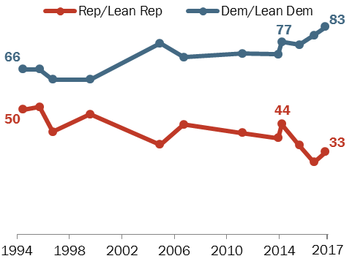
U.S. public continues to view diplomacy as best way to ensure peace, but partisan divisions grow
% who say …
% who say good diplomacy is best way to ensure peace
Source: Survey of U.S. adults conducted June 8-18, 2017.

Slide 33
Views of trade

Slide 34
Trade tends to rank low as an issue for Americans
% who say each is a top priority for Trump and Congress
Source: Survey of U.S. adults conducted Jan. 10-15, 2018

Slide 35
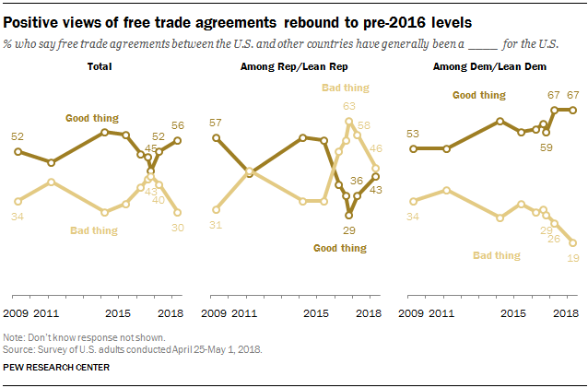
Volatility in views of free trade agreements in recent years, but a rebound to pre-2016 levels
% who say free trade agreements between the U.S. and other countries have generally been a ____ for the U.S.
Source: Survey of U.S. adults conducted April 25-May 1, 2018.

Slide 36
Republican views of free trade agreements turned negative in 2016 election, have recently improved
% who say free trade agreements between the U.S. and other countries have generally been a ____ for the U.S.
Source: Survey of U.S. adults conducted April 25-May 1, 2018.

Slide 37
Stark partisan divide on proposed tariff increases on imports of steel and aluminum
% who say raising tariffs on steel and aluminum
would be a ____for the U.S. …
Bad thing Good thing DK
Source: Survey of U.S. adults conducted April 25-May 1, 2018.

Slide 38
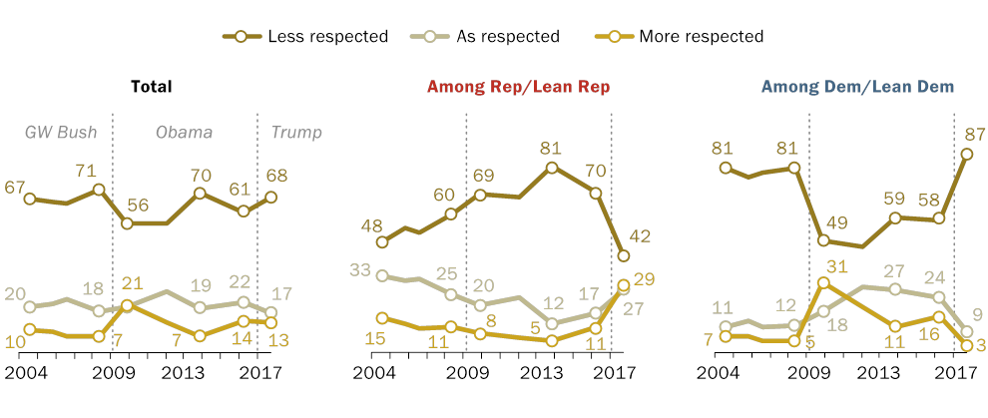
Democrats twice as likely as Republicans to say the U.S. is ‘less respected’ by other countries than in the past
% who say that, compared with the past, the U.S. is ____ by
other countries these days
Source: Survey of U.S. adults conducted Oct. 25-30, 2017.

Slide 39
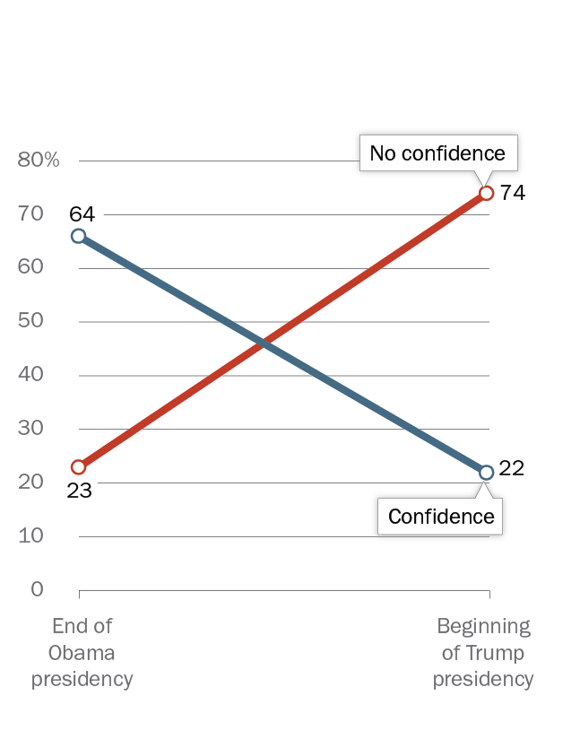
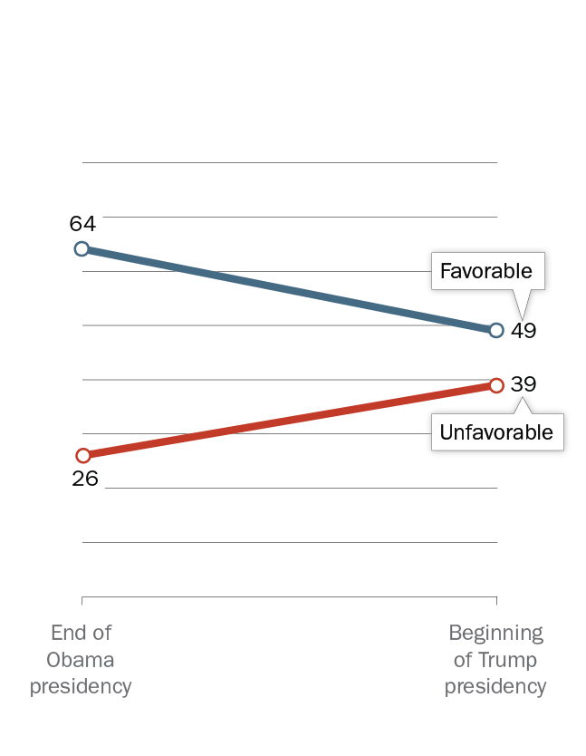
Low global confidence in Trump leads to lower ratings for U.S.
Across 37 countries…
Confidence in U.S. president
Views of U.S.
Note: Percentages are global medians based on 37 countries. Obama presidency medians are based on the most recently available data for each country between 2014 and 2016.
Notes:
Checked by caldwell

Slide 40
The U.S. Midterm Elections Approach:
The American public’s views in 2018
Jocelyn Kiley
Associate Director of Research
@jocelynkiley

