Slide 1
November, 2019 Berlin, Germany @niknanos Chief Data Scientist and President NANOS RESEARCH Chair, Board of Governors, Carleton University, Ottawa Research Professor, State University of New York
Trudeau 2.0: Implications of the 2019 Federal Election on Canadian Politics

Slide 2
Sources
2

Slide 3
Overview
2019 Canadian Federal Election
Views on Brexit
Values and partnership alignment
3

Slide 4
2019 CANADIAN FEDERAL ELECTION

Slide 5
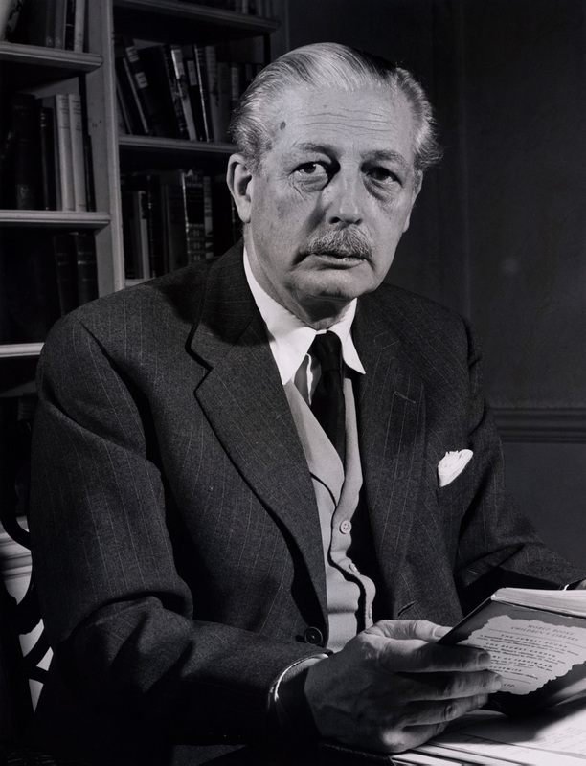
“Events, dear boy, events”
Harold Macmillan British PM (1957-63)

Slide 6
NATIONAL BALLOT
A national dual-frame (land+cell) random telephone survey is conducted nightly by Nanos Research throughout the campaign using live agents. Each evening a new group of 400 eligible voters are interviewed. The daily tracking figures are based on a three-day rolling sample comprised of 1,200 interviews. To update the tracking a new day of interviewing is added and the oldest day dropped. The margin of error for a survey of 1,200 respondents is ±2.8 percentage points, 19 times out of 20.
Contact: Nik Nanos nik@nanos.co
Ottawa: (613) 234-4666 x 237
Website: www.nanos.co
Methodology: www.nanos.co/method
Subscribe to the Nanos data portals to get access to detailed demographic and regional breakdowns.
UNDECIDED > 10%
Question: If a FEDERAL election were held today, could you please rank your top two current local voting preferences? [First ranked response]
Source: CTV, Globe, Nanos nightly election tracking ending October 20th, 2019. The data below represents the weekly tracking for August 2019. Nightly election tracking started on September 11th, 2019.

Slide 7
Qualities of a good political leader
Justin Trudeau
Andrew Sheer
Jagmeet Singh
[50%]
[39%]
[58%]
Yves-François Blanchet
Elizabeth May
Maxime Bernier
[51%]
[33%]
[13%]
QUESTION – For each of the following federal political party leaders, do you think they have or do not have the qualities to be a good political leader? [RANDOMIZE ORDER]
Source: Nanos Survey, October 20th, 2019

Slide 8
TYRANNY OF SMALL NUMBERS
17.8 million votes
23,312 swing votes
14 ridings
Liberal majority
* 17,890,264 of 27,126,166 registered electors (65.95 %) -- does not include electors who registered on election day.
Elections Canada. https://enr.elections.ca/National.aspx?lang=e
Notes:
https://www.istockphoto.com/ca/photo/imbalance-gm157680951-14430218

Slide 9
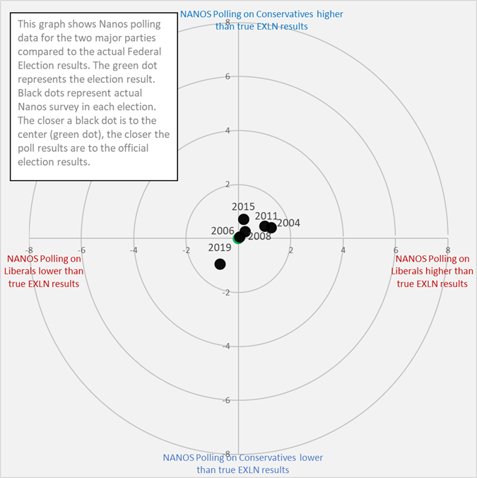
ELECTION RESULTS
Party | Sunday 20th Only | Election Results 2019 | Variance
Conservative | 32.5% | 34.4% | -1.9
Liberal | 31.7% | 33.1% | -1.4
NDP | 20.8% | 15.9% | +4.9
GPC | 6.0% | 6.5% | -0.5
BQ | 7.2% | 7.7% | -0.5
PPC | 1.5% | 1.6% | -0.1
Other | 0.3% | 0.5% | -0.2
Decided Voters | n=739
Margin of Error > 19 times out of 20 > ±3.6

Slide 10
VIEWS ON BREXIT

Canadians mention Europe most frequently as the first ranked region outside of North America with the closest affinity. Positive views of Germany in Canada on the rise.


Slide 11
Countries with closest affinity
 | First ranked (n=1013) | Second ranked (n=847)
Europe | 52.2% | 30.9%
Oceania (Australia, New Zealand, Pacific islands) | 15.9% | 31.9%
Central America and the Caribbean | 7.8% | 11.9%
South America | 3.2% | 5.5%
East and South-East Asia | 2.9% | 5.1%
Middle East and North Africa | 1.3% | 1.8%
South Asia | 1.3% | 0.7%
Eurasia (Russia and Central Asia) | 1.3% | 1.6%
Africa South of the Sahara | 1.1% | 0.7%
Unsure | 13.3% | 10.0%
QUESTION – Please rank the two regions outside of North America you feel the closest affinity to where 1 is the closest affinity and 2 the second closest affinity? [RANDOMIZE] (Source: Carleton University, September 2019)
11

Slide 12
Important aspects of Canada’s relationship with Europe
 | First ranked (n=1013) | Second ranked (n=930)
Canada and European countries both have democratic systems of government | 26.6% | 25.9%
Canada and European countries are both committed to a rules-based international order | 22.8% | 24.0%
Canada has historical ties to Europe | 20.7% | 20.2%
Canada has close economic relations with European countries | 14.2% | 16.3%
Canada’s culture is shaped by Europe | 8.3% | 10.8%
Other | 0.7% | 0.3%
Unsure/No answer | 6.0% | -
QUESTION – When you think about Canada’s relationship to Europe, please rank the following aspects of the relationship where 1 is the most important aspect and 2 is the second most important aspect of the relationship. [RANDOMIZE] (Source: Carleton University, September 2019)
12

Slide 13
View of the European Union
 | Very positive/ somewhat positive
Atlantic (n=88) | 70.9%
Quebec (n=236) | 78.7%
Ontario (n=308) | 72.9%
Prairies (n=221) | 69.4%
British Columbia (n=160) | 76.9%
Male (n=547) | 75.6%
Female (n=466) | 72.4%
18 to 34 (n=250) | 76.1%
35 to 54 (n=384) | 74.8%
55 plus (n=379) | 72.0%
Liberal (n=389) | 82.3%
Conservative (n=292) | 57.0%
Net score
+58.0
*Weighted to the true population proportion.
*Charts may not add up to 100 due to rounding.
QUESTION – How would you describe your overall view of the European Union? (Source: Carleton University, September 2019)
13

Slide 14
Sympathy towards Brexit
 | Unsympathetic/ somewhat unsympathetic
Atlantic (n=88) | 67.1%
Quebec (n=236) | 63.5%
Ontario (n=308) | 65.0%
Prairies (n=221) | 58.6%
British Columbia (n=160) | 70.3%
Male (n=547) | 65.0%
Female (n=466) | 63.8%
18 to 34 (n=250) | 66.4%
35 to 54 (n=384) | 58.8%
55 plus (n=379) | 67.9%
Liberal (n=389) | 76.2%
Conservative (n=292) | 42.8%
Net score
-41.2
*Weighted to the true population proportion.
*Charts may not add up to 100 due to rounding.
QUESTION – The term “Brexit” is used to describe the United Kingdom’s decision to leave the European Union. How sympathetic are you towards the idea of Brexit? (Source: Carleton University, September 2019)
14

Slide 15
Positive partner with Canada
Net score
+84.5
+78.7
+73.6
+53.8
+0.5
-33.1
*Charts may not add up to 100 due to rounding
QUESTION – Do you have a positive, a somewhat positive, a neutral, a somewhat negative or negative opinion of the following countries in terms of being a positive partner with your country? [RANDOMIZE] (Source: Nanos and University of Buffalo, September 2019)
15

Slide 16
Positive partner with the US
Net score
+76.5
+69.4
+52.5
+48.7
+12.2
-16.2
*Charts may not add up to 100 due to rounding
QUESTION – Do you have a positive, a somewhat positive, a neutral, a somewhat negative or negative opinion of the following countries in terms of being a positive partner with your country? [RANDOMIZE] (Source: Nanos and University of Buffalo, September 2019)
16

Slide 17
Positive partner with Mexico
Net score
+86.3
+72.7
+72.4
+67.5
+59.5
+25.8
*Charts may not add up to 100 due to rounding
QUESTION – Do you have a positive, a somewhat positive, a neutral, a somewhat negative or negative opinion of the following countries in terms of being a positive partner with your country? [RANDOMIZE] (Source: Nanos and University of Buffalo, September 2019)
17

Slide 18
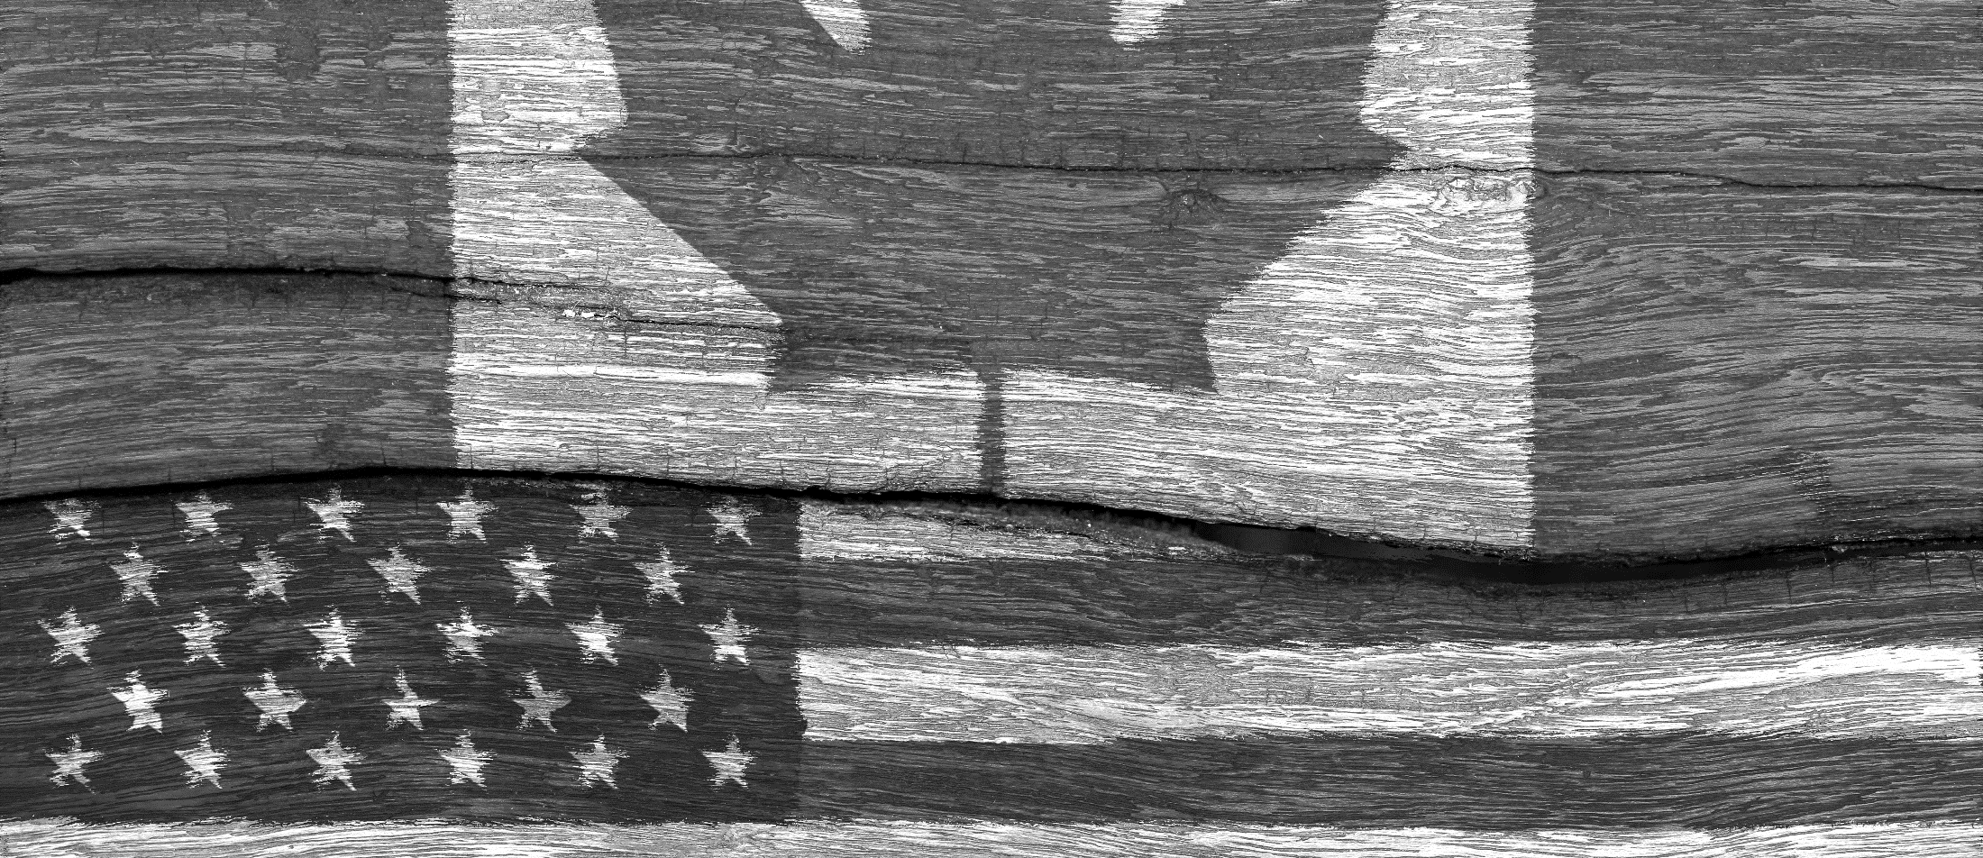
Canadians, Americans and Mexicans on human rights
Canada
United States
Mexico
[41%]
[46%]
[37%]
Canada
Britain
Canada
[22%]
[28%]
[25%]
The US
Germany
Britain
[19%]
[7%]
[10%]
China
The US
France
Ranked with the highest frequency of which country Canadians feel are closest in terms of human rights
Ranked with the highest frequency of which country Americans feel are closest in terms of human rights
Ranked with the highest frequency of which country Mexicans feel are closest in terms of human rights
QUESTION – Thinking about Canada/the US/Mexico in relation with the countries below, could you please identify the first and second ranked countries that are closest with Canada/the US/Mexico in terms of human rights? (Source: Nanos and University of Buffalo, September 2019)
18

Slide 19
Canadians, Americans and Mexicans on business values
Canada
United States
Mexico
[34%]
[25%]
[33%]
The US
The US
Canada
[32%]
[21%]
[21%]
Canada
Britain
Britain
[17%]
[16%]
[18%]
China
Germany
China
Ranked with the highest frequency of which country Canadians feel are closest in terms of business values
Ranked with the highest frequency of which country Americans feel are closest in terms of business values
Ranked with the highest frequency of which country Mexicans feel are closest in terms of business values
QUESTION – Thinking about Canada/the US/Mexico in relation with the countries below, could you please identify the first and second ranked countries that are closest with Canada/the US/Mexico in terms of business values? [FIRST RANKED] (Source: Nanos and University of Buffalo, September 2019)
19

Slide 20
Canadian sentiment towards Germany over time
Business values
Human rights
CAN > | PM Martin | PM Harper | PM Trudeau
CAN > | PM Martin | PM Harper | PM Trudeau
QUESTION – Thinking about Canada in relation with the countries below, could you please identify the first and second ranked countries that are closest with Canada in terms of business values? [ROTATE][FIRST RANKED] (Source: Nanos and University of Buffalo, September 2019)
QUESTION – Thinking about Canada in relation with the countries below, could you please identify the first and second ranked countries that are closest with Canada in terms of human rights? [ROTATE][FIRST RANKED] (Source: Nanos and University of Buffalo, September 2019)
20

Slide 21
Perceived stability may be the primary frame for foreign relations
Election lacking a focus on major issues – more focused on gotcha politics
Little sympathy for Brexit > views of Germany on the rise
Election scenario outcomes for the House of Commons

