Slide 1

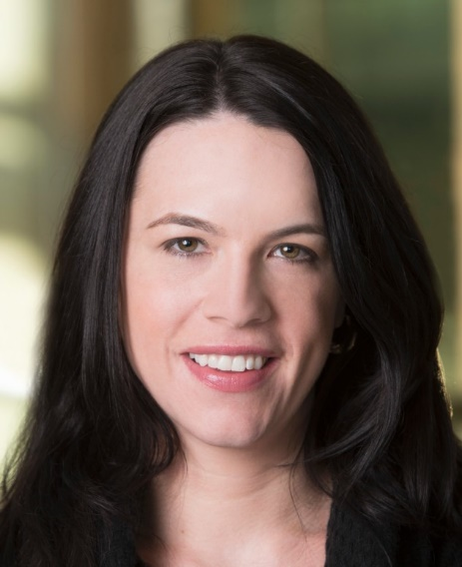

U.S. Public Opinion, the Pandemic and the 2020 Election
Jocelyn Kiley
Associate Director, Political Research
@jocelynkiley

Slide 2
Who we are: A nonprofit ‘fact tank’ that informs the public about the issues, attitudes and trends shaping the world. We are nonpartisan and nonadvocacy, meaning we do not take policy positions or make recommendations.
We are a subsidiary of The Pew Charitable Trusts, our primary funder. We partner strategically with philanthropists and institutional funders who share our commitment to impartial research and data that drive discussion.
What we do: Generate a foundation of facts to enrich public dialogue and support sound decision-making. We conduct public opinion polling, demographic research, content analysis and data-driven social science research.

Slide 3
Research Programs
U.S. Politics & Policy
Journalism & Media
Social & Demographic Trends
Religion & Public Life
Internet & Technology
Science & Society
Global Migration & Demography
Global Attitudes & Trends
Research Methodology
Data Labs
Notes:
Our Methods

Slide 4
Covid-19: national response and impact

Slide 5
Bipartisan view that COVID-19 ‘major threat’ to national economy, big partisan gap on threat to public health
% who say the coronavirus outbreak is a major threat to …
Source: Survey of U.S. adults conducted April 29-May 5, 2020

Slide 6
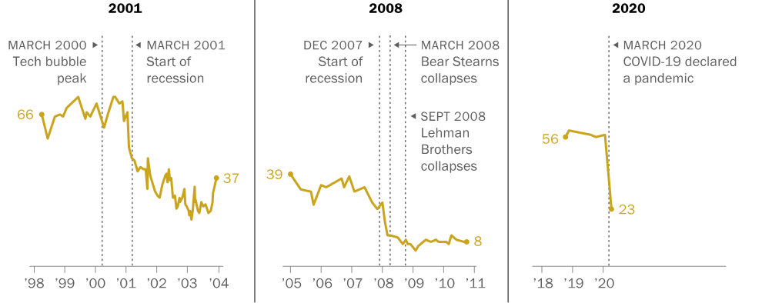
Steeper decline in national economic ratings amid coronavirus outbreak than during past economic downturns
% who rate national economic conditions as excellent or good
Notes: Data from 1998-2003 is from telephone surveys conducted by Gallup. Data from 2005-2011 is from telephone surveys by Pew Research Center. Data from 2018-2020 is from Pew Research Center’s online American Trends Panel.
Source: Survey of U.S. adults conducted April 7-12, 2020.

Slide 7
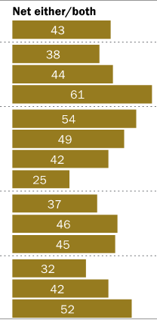
Younger people, lower-income households and Hispanics hard hit by negative job impacts caused by COVID-19
% who say they, or someone in their household, have been laid off, lost a job or taken a cut in pay because of the coronavirus outbreak
Notes: Whites and black adults include those who report being only one race and are non-Hispanic. Hispanics are of any race. “Some college” includes those with an associate degree and those who attended college but did not obtain a degree. Family income tiers are based on 2018 earnings.
Source: Survey of U.S. adults conducted April 7-12, 2020.

Slide 8
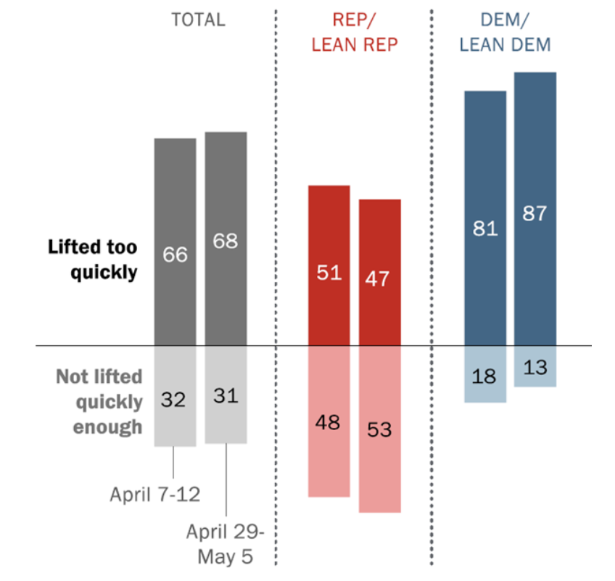
Most Americans’ greater concern has been that states will lift restrictions too quickly
% who say their greater concern is that restrictions on public activity imposed by state governments in response to the coronavirus will be …
Source: Surveys of U.S. adults conducted April-May 2020.

Slide 9
Widespread positive assessments of public health, state and local officials’ handling of outbreak – in contrast to views of Trump, media
% who rate ___ as doing an excellent/good job responding to the coronavirus outbreak
Source: Survey of U.S. adults conducted April 29-May 5, 2020.

Slide 10
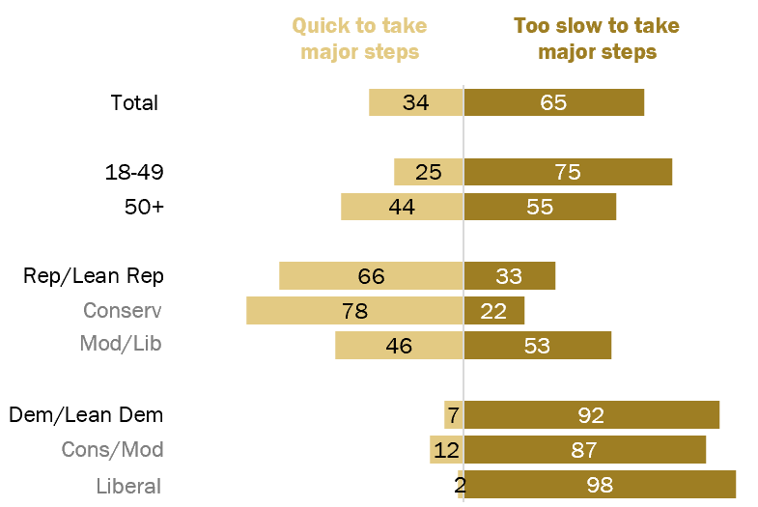
Most say Trump was too slow to respond to outbreak
% who say, thinking about when large numbers of coronavirus cases were first reported around the world, Donald Trump was __ to address the threat to the U.S.
Note: No answer responses not shown.
Source: Survey of U.S. adults conducted April 7-12, 2020

Slide 11
Trump has had higher marks for addressing needs of business than for providing accurate information during outbreak
% who rate the job Donald Trump is doing …
Source: Survey of U.S. adults conducted April 7-12, 2020.

Slide 12
COVID-19 and the election

Slide 13
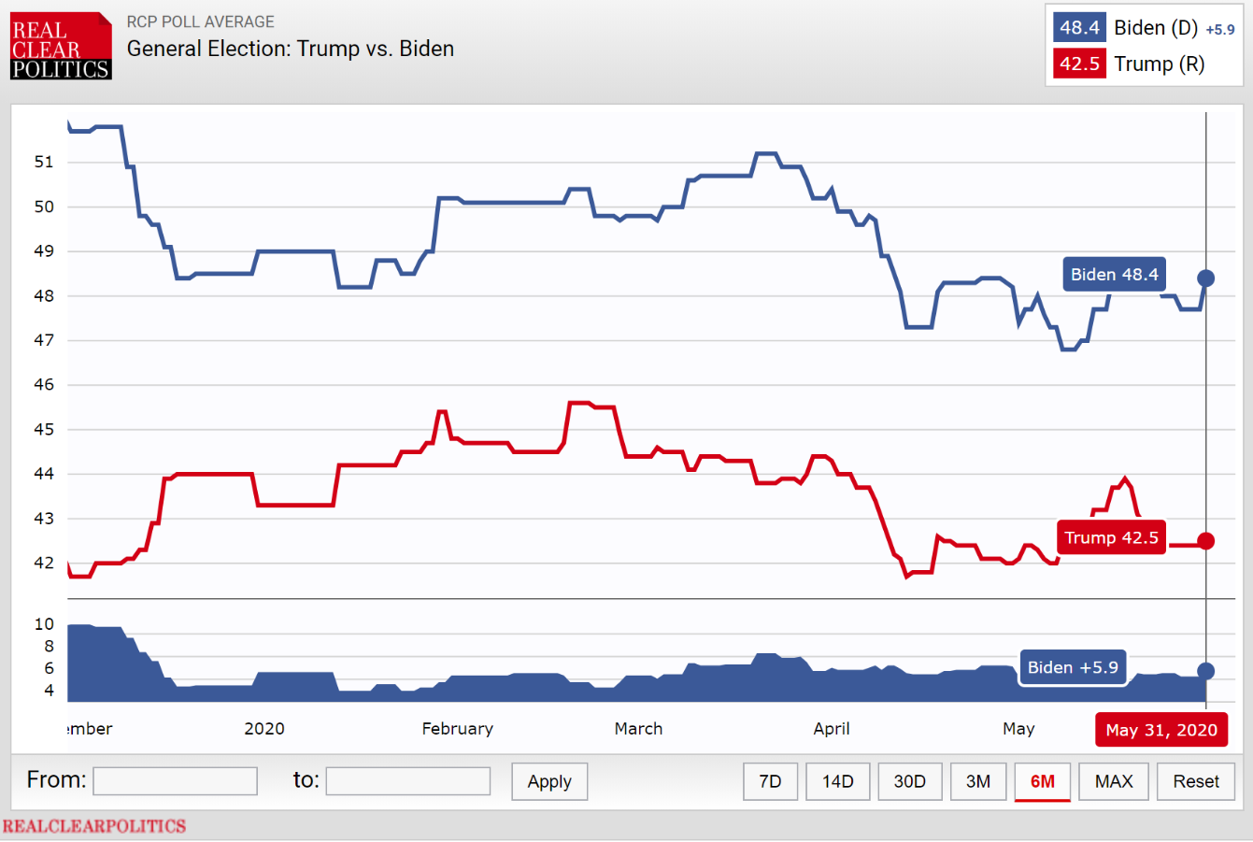

Slide 14
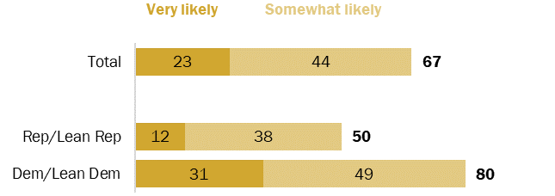
Two-thirds of Americans say it is likely the COVID-19 outbreak will disrupt the presidential election
% who say it is ___ that the coronavirus outbreak will significantly disrupt Americans’ ability to vote in the presidential election in November
Source: Survey of U.S. adults conducted April 7-12, 2020.

Slide 15
Broad support for allowing voting by mail, automatic voting registration
% who __ each of the following
Source: Survey of U.S. adults conducted April 7-12, 2020.

Slide 16
Sharp rise in Democratic support for conducting all elections by mail
% who favor conducting all elections by mail
Source: Survey of U.S. adults conducted April 7-12, 2020.

Slide 17
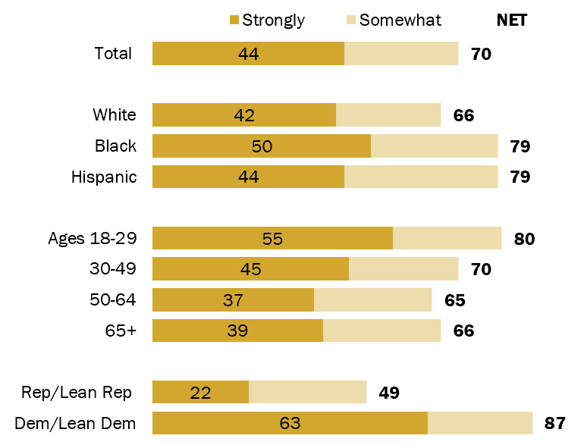
Widespread support for allowing any voter to vote by mail
% who favor allowing any voter to vote by mail if they want to
Source: Survey of U.S. adults conducted April 7-12, 2020.

Slide 18
In states with higher rates of mail-in voting, more support for expanding vote-by-mail
% who favor allowing any voter to vote by mail if they want to
Source: Survey of U.S. adults conducted April 7-12, 2020.

Slide 19
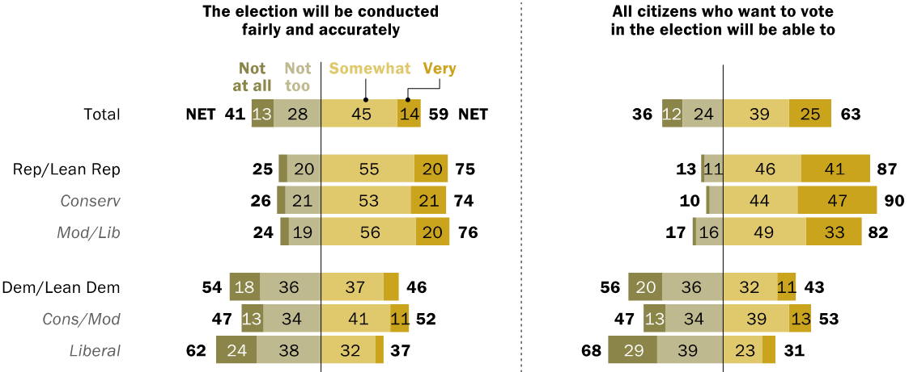
Republicans far more confident than Democrats that November election will be open, accurate
Thinking about the presidential election in November, % who say they are ___ confident that…
Source: Survey of U.S. adults conducted April 7-12, 2020.

Slide 20
Thank you. Questions?
pewresearch.org/covid

