Slide 1
Cyberattacks: How the public thinks about the state of national resilience
Richard Wike
Director, Global Attitudes

Slide 2
Pew Research Center
Established 1996
Funded by The Pew Charitable Trusts, foundations
Non-profit, non-partisan fact tank in Washington
Since 2001, we have surveyed in 108 countries
www.pewresearch.org
@pewresearch

Slide 3
Methodology
Survey conducted across 26 countries from May 14 to August 12, 2018, totaling 27,612 respondents
Based on telephone and face-to-face interviews with nationally representative samples of adults 18 and older
The margin of sampling error for the completed set of weighted data is ±2.9% - ±5.1%

Slide 4
Global threat perceptions

Slide 5
Global Threats Included in 2018 Survey
I’d like your opinion about some possible international concerns for (survey country). Do you think that __ is a major threat, a minor threat, or not a threat to (survey country)?
China’s power and influence
the United States’ power and influence
Russia’s power and influence
global climate change
the Islamic militant group known as ISIS
cyberattacks from other countries
North Korea’s nuclear program
the condition of the global economy
Note: Battery items were randomized.

Slide 6
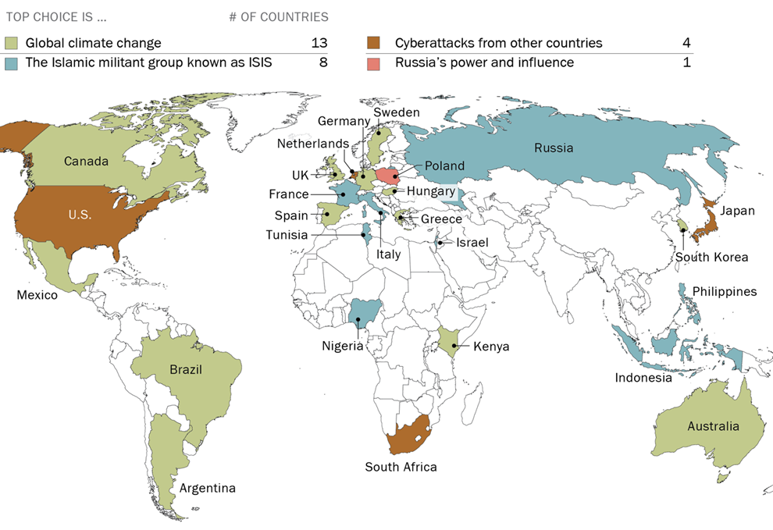
Climate Change is Seen by More Countries as a Top Threat, but Many People Also Name ISIS & Cyberattacks as Top Security Concern
Note: U.S. power and influence question not asked in the U.S., and Russia’s power and influence not asked in Russia.

Slide 7
Across Much of Europe and North America, Climate Change is a Top Concern, but so are ISIS and Cyberattacks
Top choice
__ is a major threat to our country
Global climate change | ISIS | Cyberattacks from other countries | North Korea’s nuclear program | Russia’s power and influence
—

Slide 8
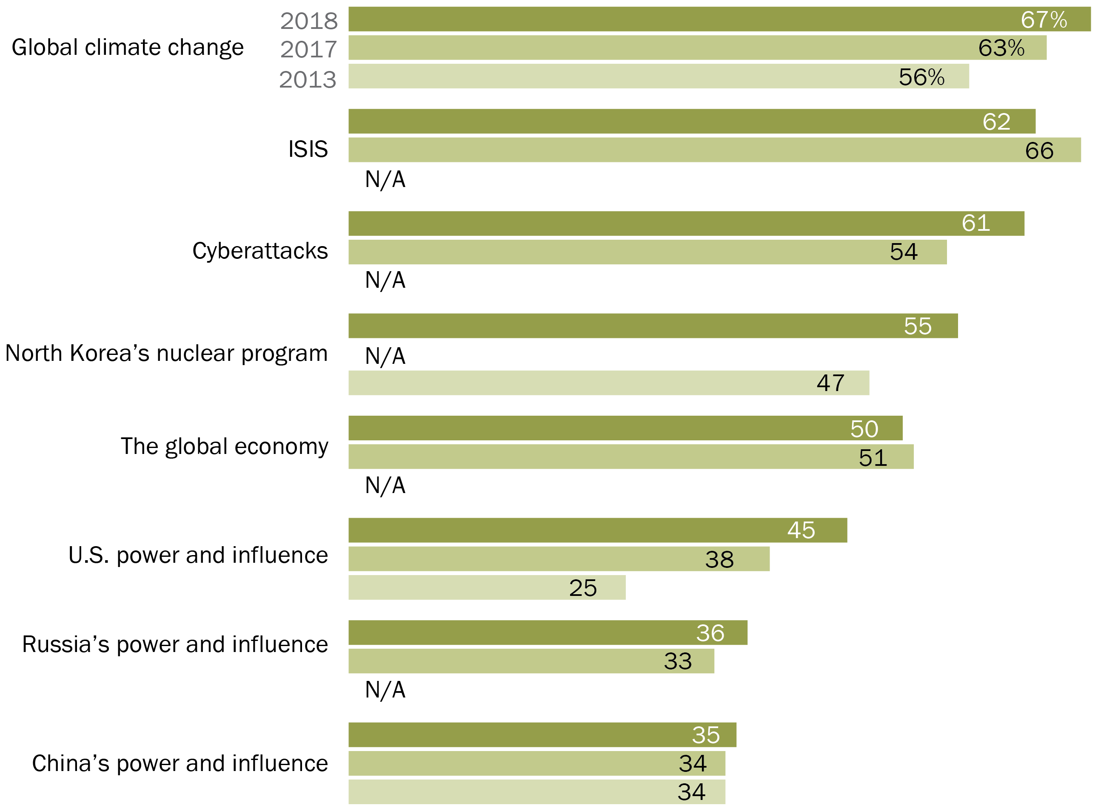
Publics Around the World Increasingly See Climate Change, Cyberattacks and American Power as Threats
__ is a major threat to our country
2018
Global climate change
2017
2013
N/A
N/A
N/A
N/A
N/A
Note: Figures are medians across 23 countries surveyed in 2013, 2017 and 2018. Hungary, Netherlands and Sweden not included due to lack of trend data from 2013. U.S. power and influence question not asked in the U.S., and Russia’s power and influence question not asked in Russia

Slide 9
The Likelihood of Cyberattacks

Slide 10
People Say Cyberattacks on National Security Information, Public Infrastructure and Elections are Likely in Their Country
It is __ that, in the future, a cyberattack will result in…
Our country’s sensitive national security information being accessed
Public infrastructure in our country being damaged
Elections in our country being tampered with
Note: Percentages are medians based on 26 countries. “Likely” includes those who say a cyberattack is “very” or “somewhat” likely and those
who volunteer that such attacks have already happened.
Source: Spring 2018 Global Attitudes Survey.

Slide 11
Majorities in Europe, U.S. and Canada Believe Future Cyberattacks Will Breach National Security
It is __ that, in the future, a cyberattack will result in our country’s sensitive national security information being accessed
Note: Total includes those who say a cyberattack is “very” or “somewhat” likely and those who volunteer such attacks have already
happened.
Source: Spring 2018 Global Attitudes Survey.

Slide 12
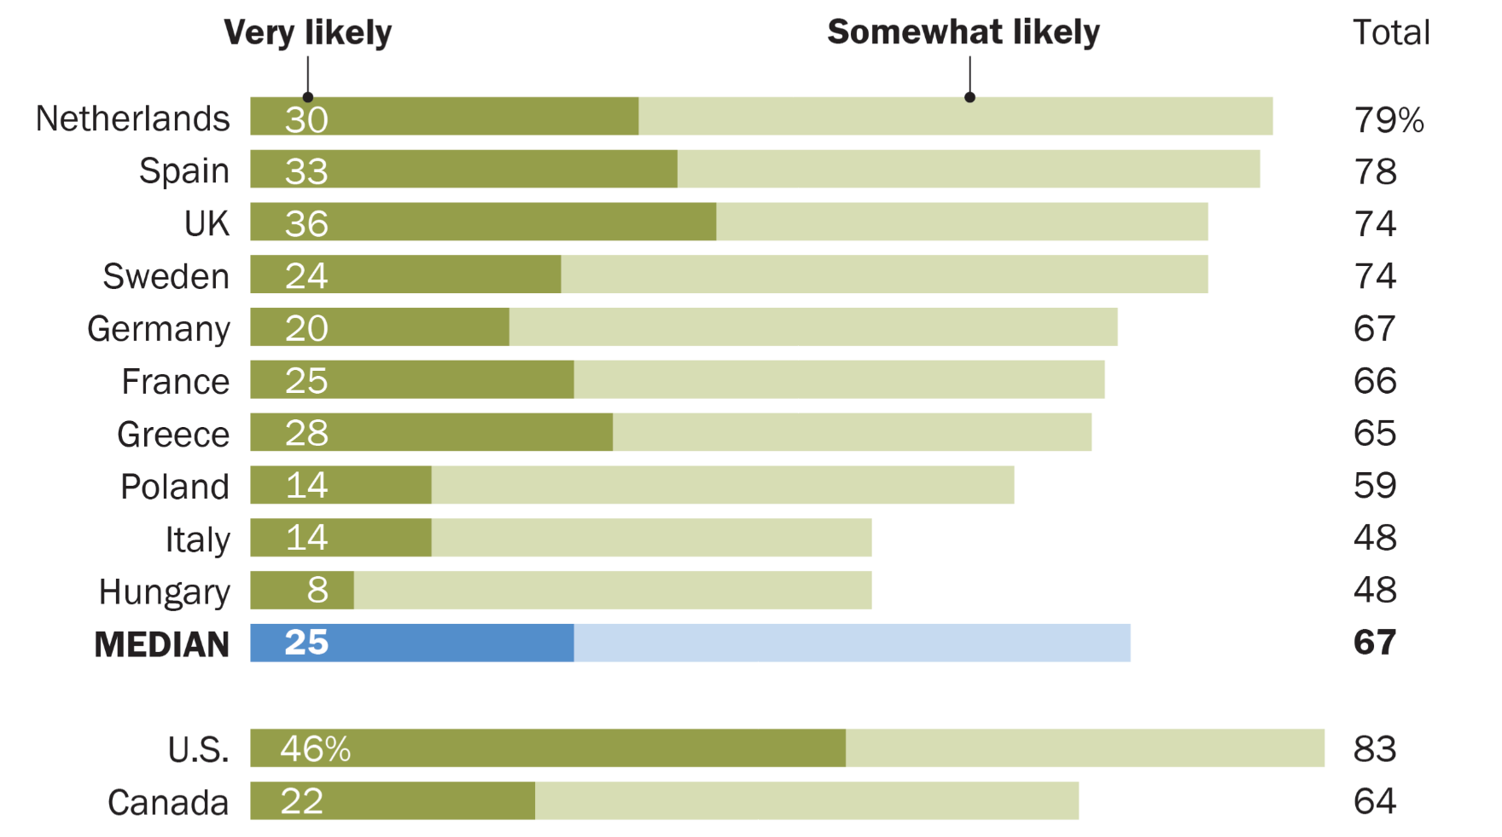
Many in Western Europe, U.S., Canada Believe Future Cyberattacks Will Damage Infrastructure
It is __ that, in the future, a cyberattack will result in public infrastructure in our country being damaged
Note: Total includes those who say a cyberattack is “very” or “somewhat” likely and those who volunteer such attacks have already
happened.
Source: Spring 2018 Global Attitudes Survey.

Slide 13
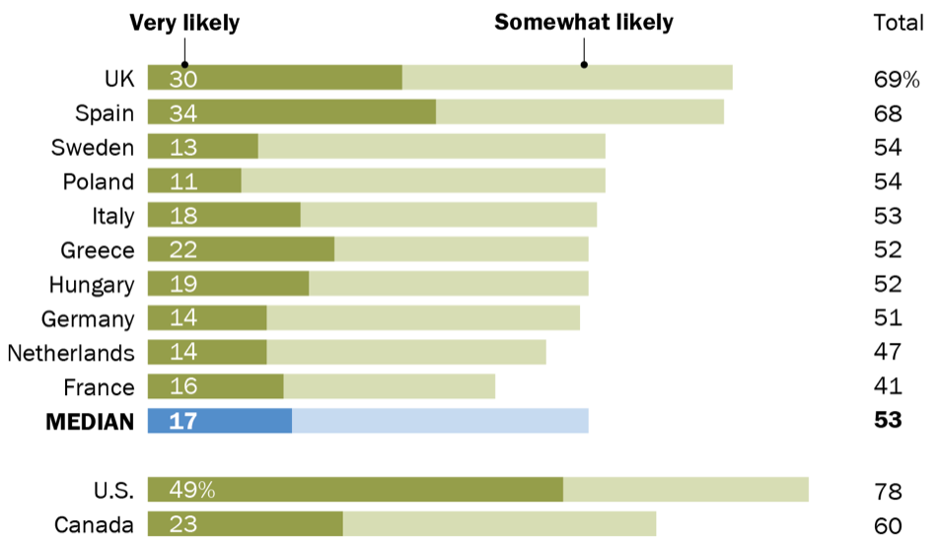
Roughly Half in European Nations Believe Cyberattacks Will Result in Election Tampering
It is __ that, in the future, a cyberattack will result in elections in our country being tampered with
Note: Total includes those who say a cyberattack is “very” or “somewhat” likely and those who volunteer such attacks have already
happened.
Source: Spring 2018 Global Attitudes Survey.

Slide 14
Democrats More Worried Than Republicans About Potential Election Tampering via Cyberattack
It is likely that, in the future, a cyberattack will result in …
Note: Statistically significant difference in bold. “Likely” includes those who say a cyberattack is “very” or “somewhat” likely and those who volunteer that such attacks have already happened.
Source: Spring 2018 Global Attitudes Survey.

Slide 15
How well prepared is your government?

Slide 16
Differing Views on How Well Nations are Prepared to Handle Cyberattacks
Our country is __ prepared to handle a major cyberattack
Note: “Don’t know” and “Refused” responses not shown.
Source: Spring 2018 Global Attitudes Survey.

Slide 17
Differing Views on How Well Nations are Prepared to Handle Cyberattacks
Our country is __ prepared to handle a major cyberattack
Note: “Don’t know” and “Refused” responses not shown.
Source: Spring 2018 Global Attitudes Survey.

Slide 18
People Who Support the Party in Power are More Likely to Say Their Country is Ready for Cyberattack
Our country is well prepared to handle a major cyberattack
Note: All differences shown are statistically significant. See Appendix for list of governing parties by country.
Source: Spring 2018 Global Attitudes Survey.

Slide 19
All Pew Research Center reports are available online at www.pewresearch.org
Richard Wike
Director, Global Attitudes Research
@RichardWike

