Slide 1
European Public Opinion Three Decades After the Fall of Communism
Laura Silver
Senior Researcher
@lauraruthsilver

Slide 2
Pew Research Center
Established 1996
Funded by The Pew Charitable Trusts, foundations
Non-profit, non-partisan fact tank in Washington
Since 2001, we have surveyed in 108 countries
www.pewresearch.org
@pewresearch

Slide 3
Methodology
Survey conducted across 17 countries from May 13 to August 12, 2019, totaling 18,979 respondents
Based on telephone and face-to-face interviews with nationally representative samples of adults 18 and older
The margin of sampling error for the completed set of weighted data is ±2.9% to ±4.7%

Slide 4
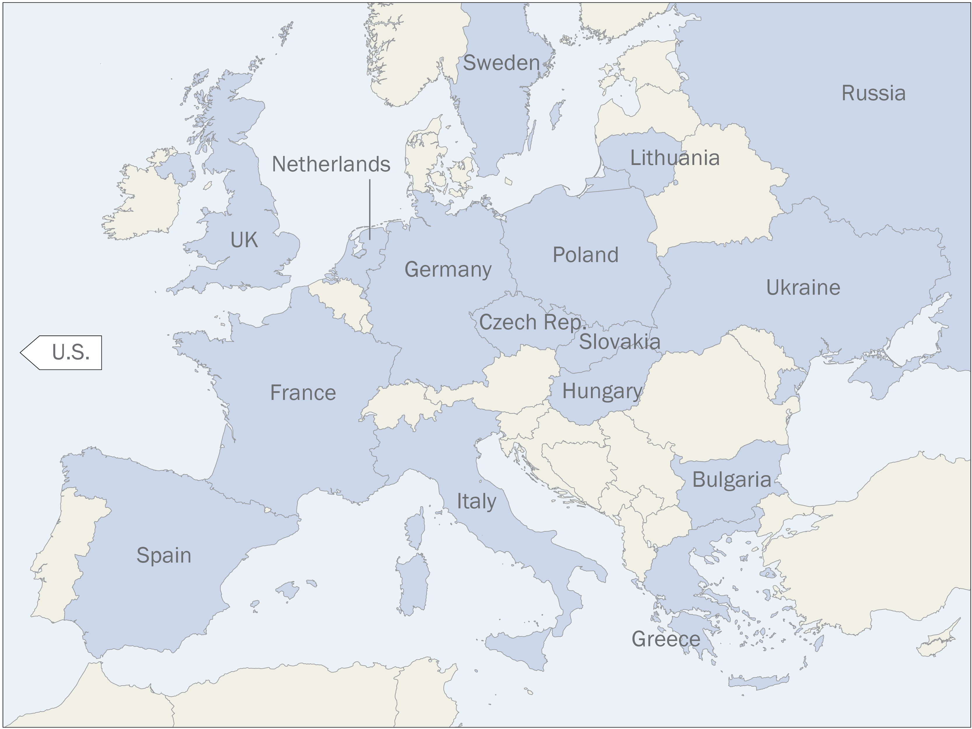
Country coverage

Slide 5
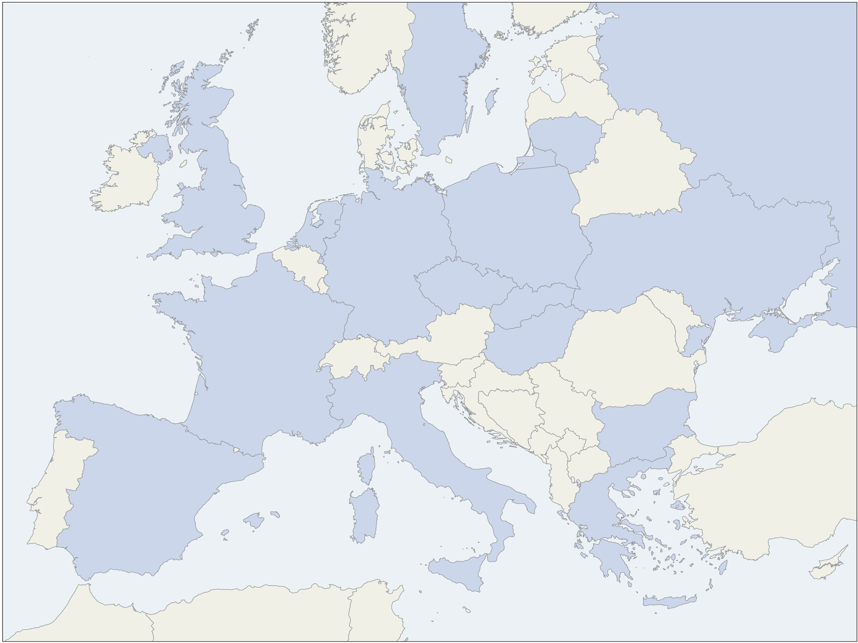
THE POST-COMMUNIST TRANSITION

Slide 6
Most approve of shift to multiparty and free market systems
% who approve that their country changed from one-party rule/state-controlled economy to a …
Multiparty system
Market economy
Source: Spring 2019 Global Attitudes Survey.

Slide 7
Publics divided over economic situation after communism
% who say that the economic situation for most people today is __ than it was under communism
Source: Spring 2019 Global Attitudes Survey.

Slide 8
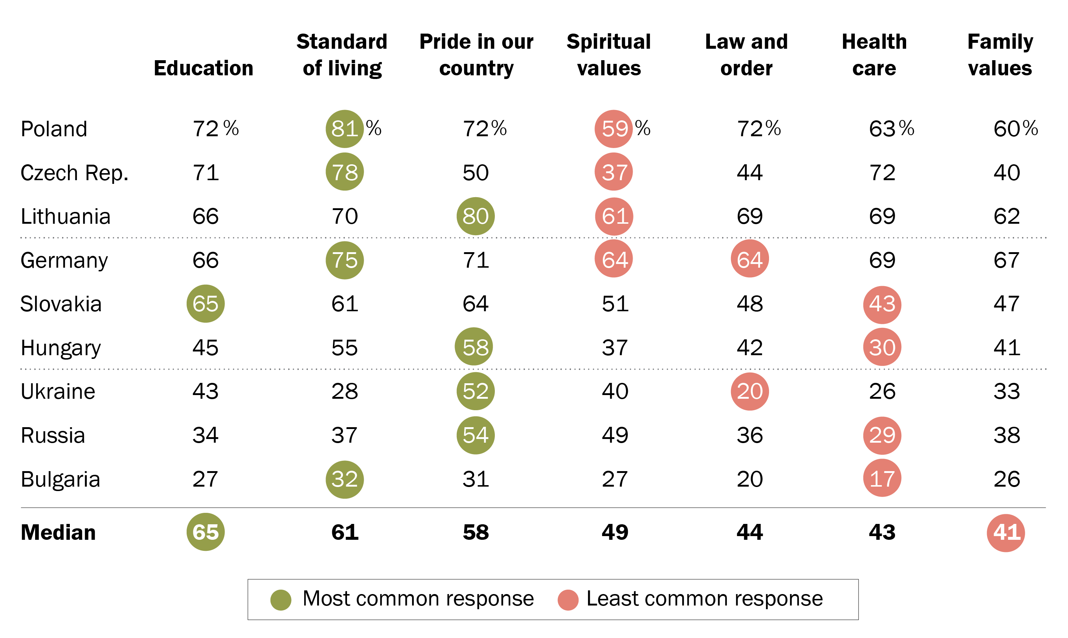
Opinion of post-communism changes
% who say changes since 1989/1991 have had a very good/good influence on ...
Source: Spring 2019 Global Attitudes Survey.

Slide 9
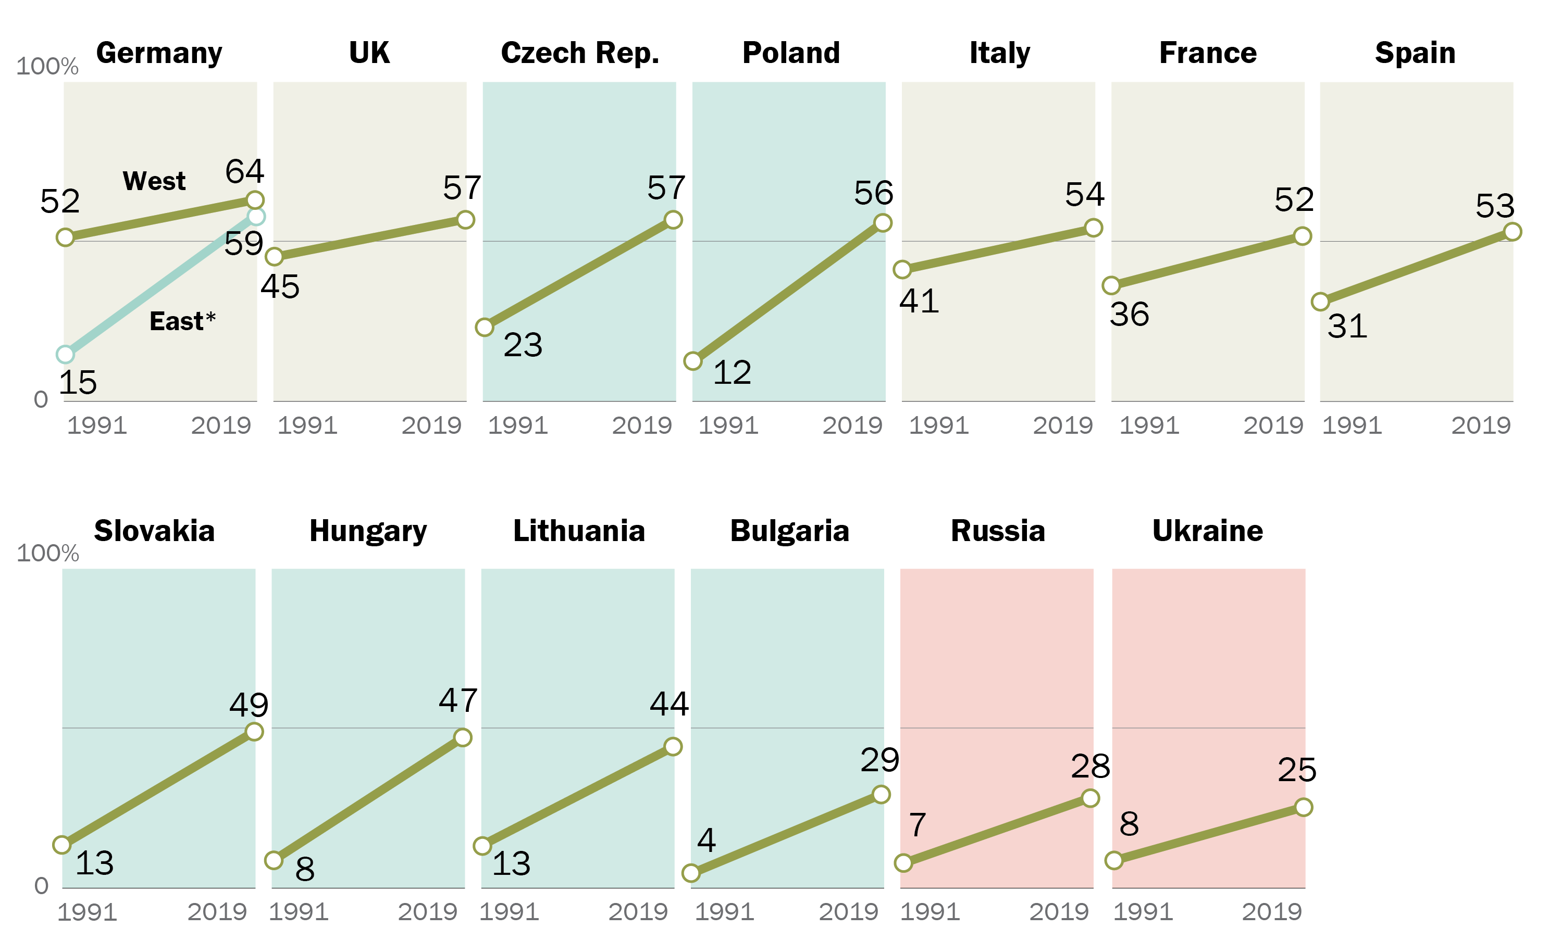
Since 1991, life satisfaction has improved across Europe
% who say 7, 8, 9 or 10 on a ladder of life where the top of the ladder (10) represents the best possible life
* East and West Germany respondents live in former German Democratic Republic and pre-1990 Federal Republic of Germany, respectively.
Source: Spring 2019 Global Attitudes Survey.
Notes:
.

Slide 10
Politicians, business people seen to benefit post-communism
% who believe that __ have benefited a great deal/fair amount from the changes since 1989/1991
Source: Spring 2019 Global Attitudes Survey.

Slide 11
DEMOCRACY AND THE EUROPEAN PROJECT

Slide 12
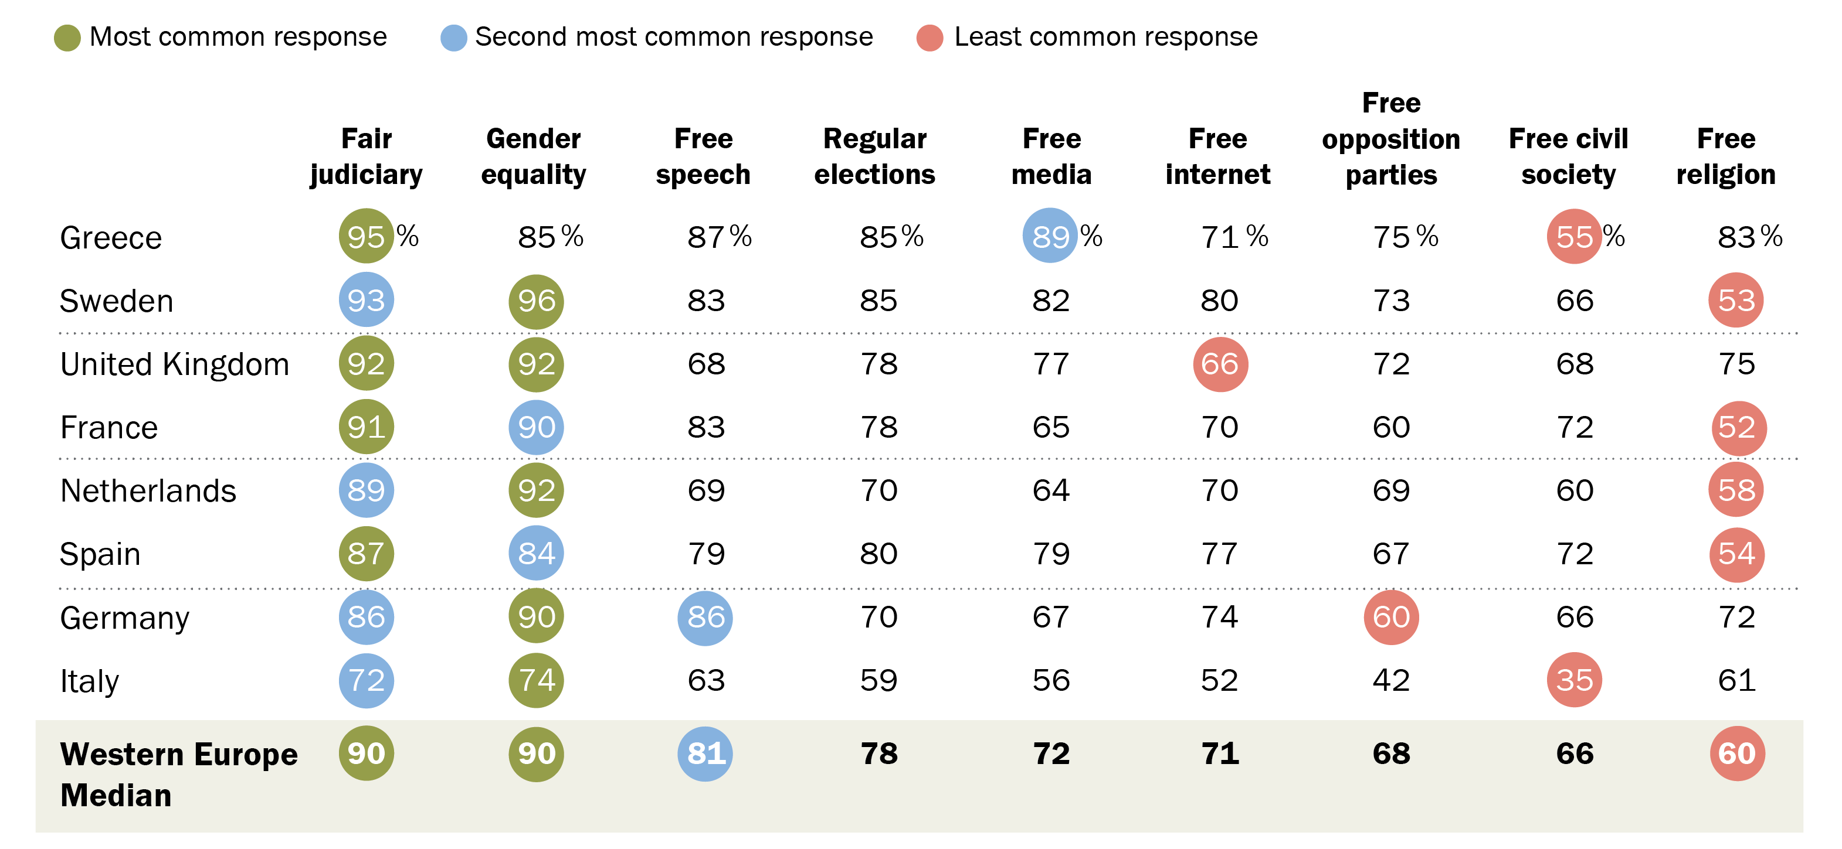
Judicial fairness, gender equality top priorities for most Western Europeans
% who say it is very important to have __ in their country
UK
Source: Spring 2019 Global Attitudes Survey.

Slide 13
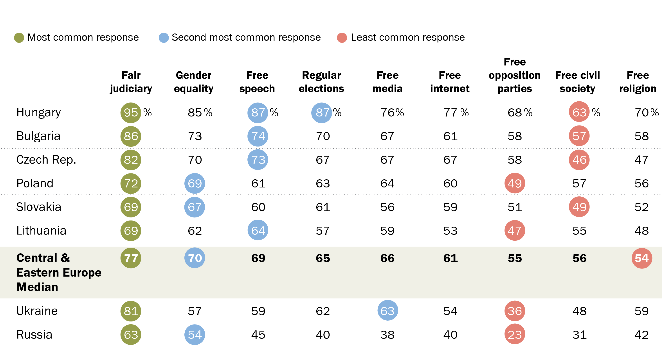
Fair judiciary most important in Central and Eastern Europe
% who say it is very important to have __ in their country
Source: Spring 2019 Global Attitudes Survey.

Slide 14
Most Europeans think voting gives people like them a say
% who __ that voting gives people like them some say about how the government runs things
Source: Spring 2019 Global Attitudes Survey.

Slide 15
Dissatisfaction with democracy is common in Europe
% who say they are __ with the way democracy is working in their country
Source: Spring 2019 Global Attitudes Survey.

Slide 16
Most across Europe are skeptical of their governing elite
% who __ that most elected officials care what people like them think
Source: Spring 2019 Global Attitudes Survey.

Slide 17
Largely positive views about the EU, its impact
% who say…
Source: Spring 2019 Global Attitudes Survey.

Slide 18
VIEWS ABOUT the Future

Slide 19
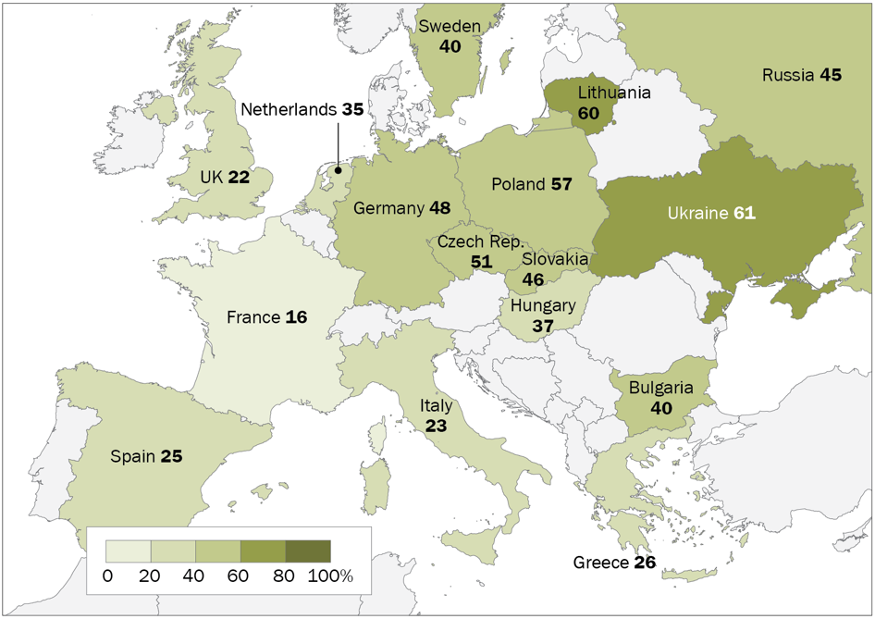
Optimism about financial future of children today
% who say children today will be better off financially than their parents
Source: Spring 2019 Global Attitudes Survey.

Slide 20
Most are optimistic about relations with other European nations and their own country’s culture
% who say they feel __ about…
Note: Percentages are medians based on 14 European Union countries.
Source: Spring 2019 Global Attitudes Survey.

Slide 21
All Pew Research Center reports are available online at www.pewresearch.org
Laura Silver
Senior Researcher
@lauraruthsilver

